Slide 1
Quality-of-Service (QoS) for Virtual Networks in OpenFlow MPLS Transport Networks
Ashiq Khan*, Wolfgang Kiess, David Perez-Caparros, Joan Triay
*NTT DOCOMO, Inc., Japan
DOCOMO Communications Labs, Germany
IEEE CloudNet, Nov 11-13, 2013
San Francisco

Slide 2
Contents
Background and Objective
QoS in MPLS: an overview
Proposal
Evaluation: prototype
Conclusions

Slide 3
Background
OpenFlow virtualizes/slices transport networks easily
Lacks scalability, QoS support
MPLS is scalable, has carrier-grade QoS support
Lacks virtualization capability when it comes to QoS
Cloud/Datacenter
OpenFlow
OpenFlow
OpenFlow
Cloud/Datacenter
Cloud/Datacenter
MPLS transport domain
Impractical to replace all MPLS switches in one day…. but then,
How to accommodate multiple virtual networks with QoS guarantee

Slide 4
Objective
Accommodate multiple virtual networks in MPLS domain
MPLS can isolate multiple QoS classes
but, multiple VNs mean isolating now within a QoS class
5G
Video (QoS-1)
4G
5G
Voice (QoS-0)
4G
MPLS switch
MPLS switch
How can we realize this without changing MPLS implementations

Slide 5
MPLS QoS support overview
MPLS defines two bandwidth constraint models
Maximum Allocation Model (MAM)
Russian doll Model (RDM)
Strict BW isolation among classes
Aggregated BW to a set of classes
C2
Maximum
Reservable
Bandwidth
C2
+
C1
+
C0
Maximum
Reservable
Bandwidth
C1
C1
+
C0
C0
C0
a. MAM
b. RDM
Unused BW are wasted
Complex management and preemption task
Both classes need to be addressed for multiple VN accommodation

Slide 6
Creating multiple virtual networks …. principle
Without any special support from MPLS
Transparent to MPLS
VN-0
VN-1
C2
+
C1
+
C0
C2
C1
+
C0
Maximum
Reservable
Bandwidth
C0
Maximum
Reservable
Bandwidth
C2
+
C1
+
C0
C1
C2
+
C1
+
C0
C1
+
C0
C1
+
C0
C0
C0
C0
a. MAM
b. RDM
Need a flexible, programmable admission control mechanism

Slide 7
Proposed architecture
OpenFlow (OF) as the Admission Controller to the MPLS domain
Per VN reservation state
Info from MPLS domain
VN
QoS class
Max BW
Available BW
QoS
class
MPLS
Max BW
MPLS
Available BW
Session Establishment Request
VN-0
C0
6
0
+
C0
10
3
Session data transfer
C1
7
4
VN-1
C0
4
3
C1
VN-0
C1
8
6
15
10
VN-1
LER: Label Edge Router
LSR: Label Switching Router
Source/Destination
OpenFlow Controller
LSR
LSR
Source/Destination
OF Domain B
MPLS switching domain
LER
OpenFlow switch
LER
OpenFlow Domain A
LSR
Source/Destination
Source/Destination
Source/Destination
The whole process remains transparent to the MPLS domain

Slide 8
Experiment platform prototyping
Topology
Configuration
All hosts are virtual machines (Ubuntu 12.04, VMWare, HP blade center 520)
MPLS switches: MPLS kernel extension* on Debian 4
Links bandwidth: 6.3 Mbps
OpenFlow Controller
(Floodlight)
Host A
Host B
Bandwidth allocation in the MPLS domain
MPLS LER 1
MPLS QoS BW per QoS Virtual Network BW per VN
C0 40% VN1 20%
VN2 20%
C1 60% VN1 20%
VN2 40%
OpenFlow Switch
(Open vSwitch)
MPLS LSR
MPLS LER 3
Host C
MPLS LER 2
Host D
VN1: Host A, Host B VN2: Host C, Host D
*MPLS Linux Labs by Sourceforge

Slide 9
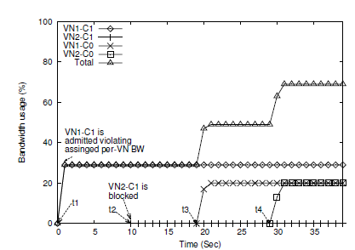
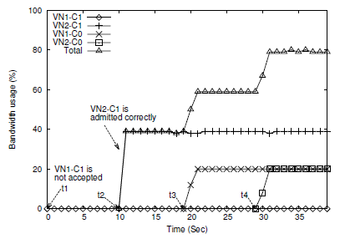
Results MAM
Achieving isolation and appropriate admission control
BW
Time Session Scenario 1 Scenario 2
t₁ VN1-C1 30% 20%
t₂ VN2-C1 40% 60%
t₃ VN1-C0 20% 20%
t₄ VN2-C0 20% 20%
Bandwidth allocation in the MPLS domain
MPLS QoS BW per QoS Virtual Network BW per VN
C0 40% VN1 20%
VN2 20%
C1 60% VN1 20%
VN2 40%
(a) without OF admission control
(b) with OF admission control
Fig: Accommodation of multiple VNs in MAM model
Isolation achieved without any modification in the MPLS domain

Slide 10
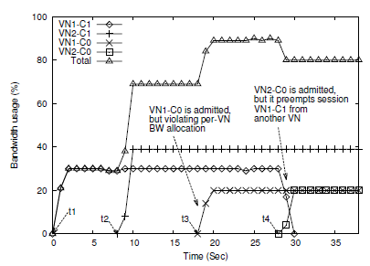
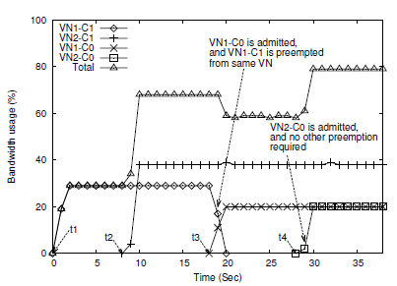
Results RDM -1
Achieving isolation, appropriate admission control and preemption
BW
Time Session Scenario 1 Scenario 2
t₁ VN1-C1 30% 20%
t₂ VN2-C1 40% 60%
t₃ VN1-C0 20% 20%
t₄ VN2-C0 20% 20%
Bandwidth allocation in the MPLS domain
MPLS QoS BW per QoS Virtual Network BW per VN
C0 40% VN1 20%
VN2 20%
C1 60% VN1 20%
VN2 40%
(a) without OF admission control
(b) with OF admission control
Fig: Accommodation of multiple VNs and consequent operations in RDM model for Scenario 1
Intra-VN preemption is also possible without any modification in MPLS

Slide 11
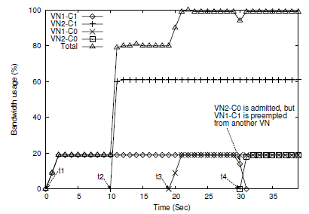
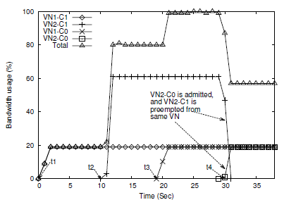
Results RDM -2
Achieving isolation, appropriate admission control and preemption
BW
Time Session Scenario 1 Scenario 2
t₁ VN1-C1 30% 20%
t₂ VN2-C1 40% 60%
t₃ VN1-C0 20% 20%
t₄ VN2-C0 20% 20%
Bandwidth allocation in the MPLS domain
MPLS QoS BW per QoS Virtual Network BW per VN
C0 40% VN1 20%
VN2 20%
C1 60% VN1 20%
VN2 40%
(a) without OF admission control
(b) with OF admission control
Fig: Accommodation of multiple VNs and consequent operations in RDM model for Scenario 2
Intra-VN preemption is also possible without any modification in MPLS

Slide 12
Conclusions
Summary
Proposed method for accommodating multiple virtual networks in MPLS
Proposed method doesn’t require any change in the MPLS domain
Verified the proposal by elementary prototype
Future Works
QoS in the OpenFlow domain
Large scale experiment
Isolation guarantee at the MPLS core

Slide 13
Ashiq Khan
khan@nttdocomo.co.jp

